Slide 1

A Comprehensive Analysis Of Bank Transaction Data: Exploring The Value Behind The Data
Data Science Mini Project
Problem C – Group 25
Bohan Liu, Haolong Li, Shuyao Yi

Slide 2
Literature Review
ROLES
METHODS
EFFECTS

Slide 3
Literature Review
METHODS
EFFECTS
Applications In Banking Industries:
Marketing Strategy Improvement
Customer Relationship Management
Risk Management
ROLES

Slide 4
Literature Review
ROLES
EFFECTS
User Profiling:
Based on real data and marketing research
Evaluating customer value
Provide basic info, behaviour habits
METHODS

Slide 5
Literature Review
ROLES
METHODS
Results From The Analysis:
Identify high-value customers
Ability to provide targeted services
Ability to identify unusual transaction
Fraud prevention and detection
EFFECTS

Slide 6
Literature Review
Customer Value
Customer Spending Habits
Customer Account Security
Main Analysis Directions

Slide 7
01
Exploratory Data
Analysis
02
03

Slide 8
Balance Difference
01
Customer Value
Taking the account average balance of 5000 pounds as Threshold:
Lower Income
Higher Income
02
03

Slide 9
01
Time Analysis
Merchant Analysis
Transaction Analysis
Customer Spending Habits
02
03

Slide 10
01
Unusual Transaction Time
Unusual Transaction Frequency
Unusual Transaction Amount
02
Customer Account Security
03

Slide 11
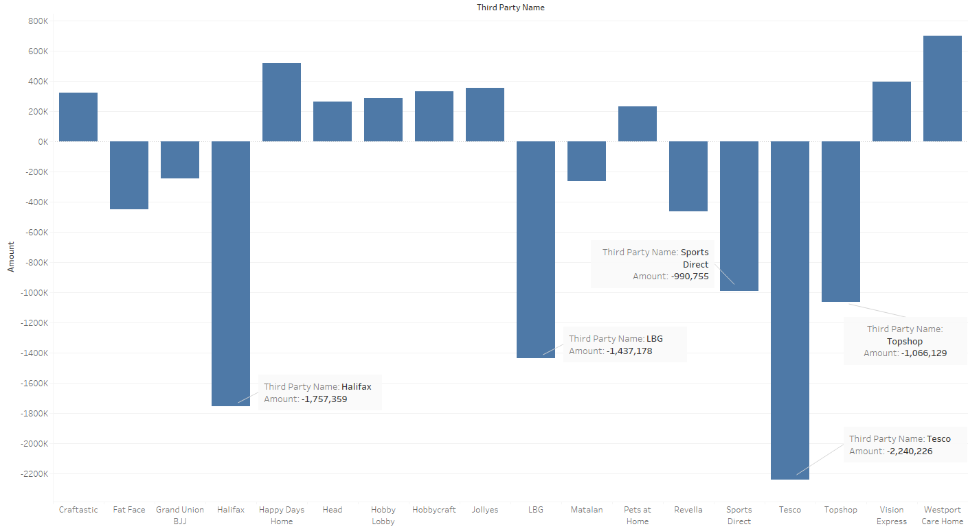
01
Lower Income

Slide 12
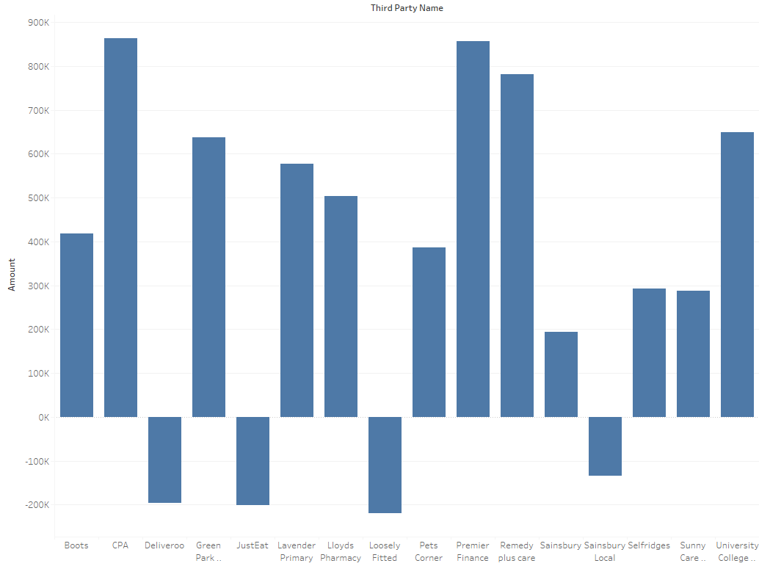
01
Higher Income

Slide 13
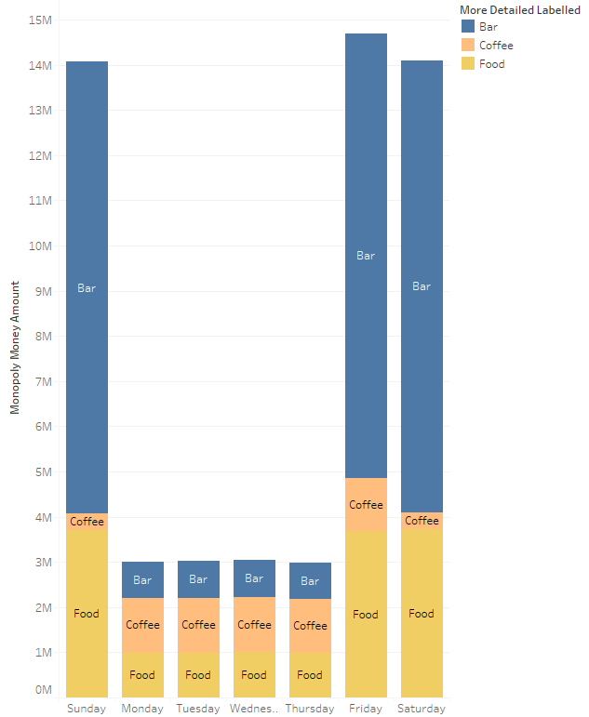
First
Dataset
02
Time Analysis

Slide 14
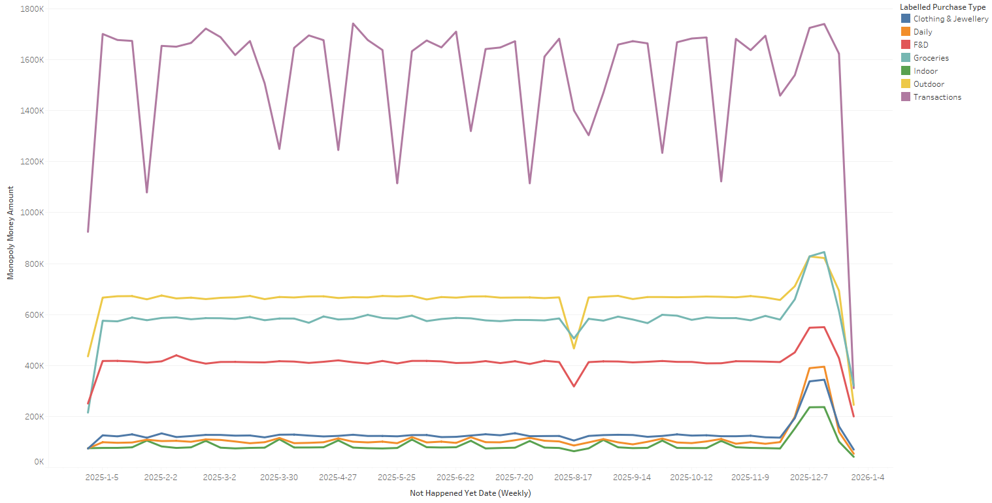
First Dataset
02
Time Analysis

Slide 15
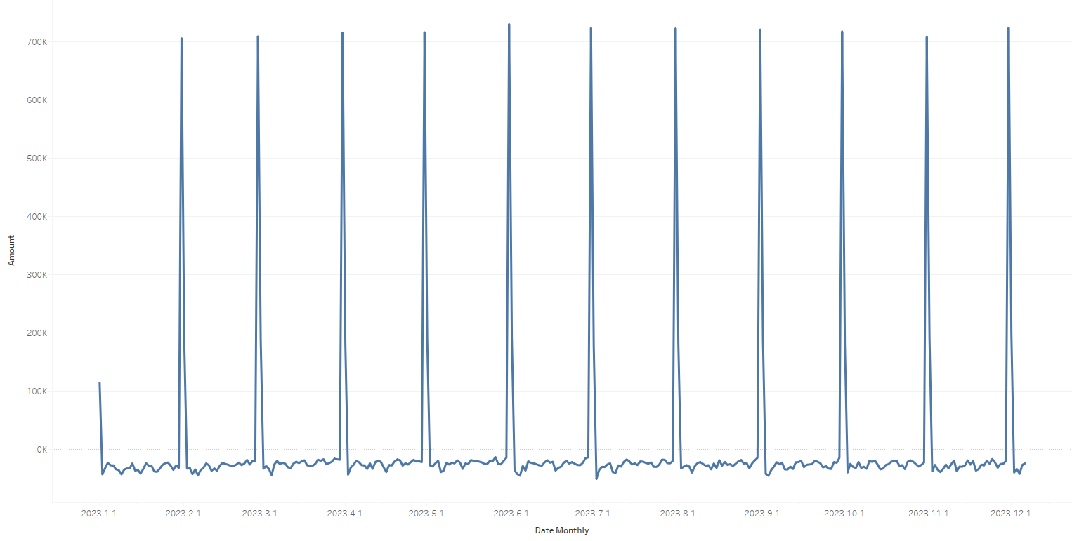
Second Dataset
02
Time Analysis

Slide 16
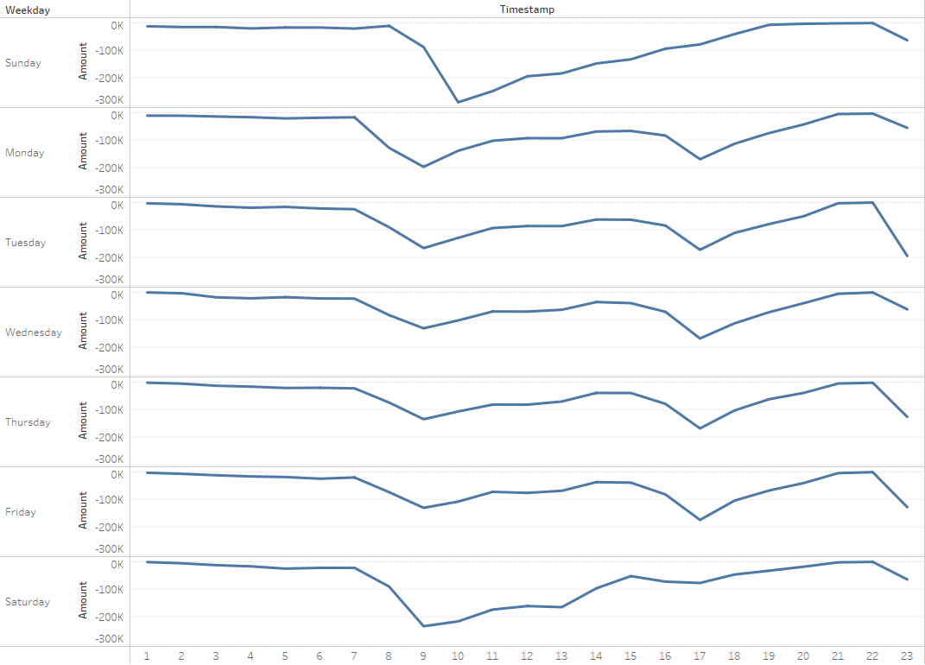
Second Dataset
02
Time Analysis

Slide 17
02
Merchant Analysis

Slide 18
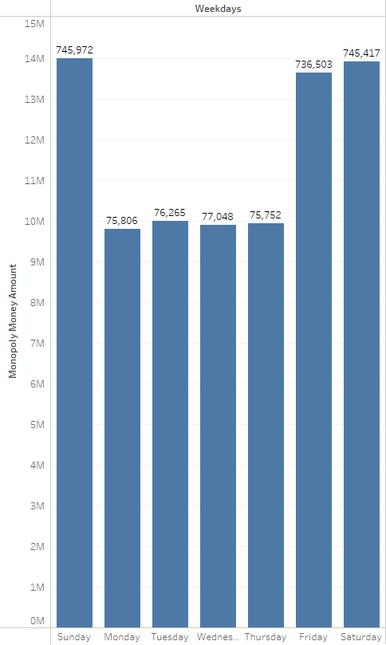
First
Dataset
02
Transaction Analysis

Slide 19
Second Dataset
02
Transaction Analysis

Slide 20
Second Dataset
02
Transaction Analysis

Slide 21

1
Higher Level Analysis:
Customer Value
RFM
CLV
Customer Spending Habits
LSTM
Customer Account Security
Isolation Forest
2
3

Slide 22
Customer Value
1
RFM Analysis:
Calculate the customers RFM level by using the quartile
Separate the customers RFM class by using the RFM level (such as 1-1-1)
CLV Analysis:
Implement a BG/NBD model to predict future purchasing
Implement a Gamma-Gamma model to estimate customers future monetary value
Calculate the CLV by using results
2
3

Slide 23
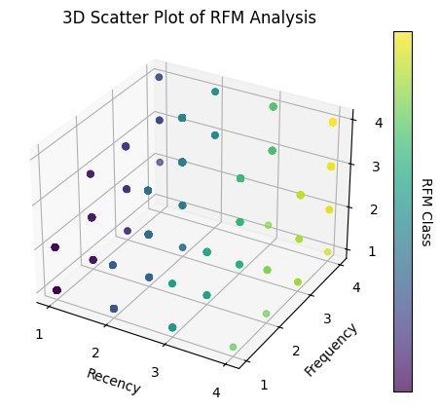
RFM Analysis
1
2
3

Slide 24
CLV Analysis
1
Example Form:
Account No | CLV Results
104832000 | 0
105375973 | 2405.0041…
106601471 | 748.79396…
…. | ….
999752672 | 333.99685…
2
3

Slide 25
Customer Spending Habits
1
LSTM:
Data Preprocessing:
Set the input (amount and tag) and output (merchant types) value sizes to 2 and 10
Parameter Tuning
Before: Loss = 1.93
After: Loss = 1.75
2
3

Slide 26
Customer Account Security
1
Fraud Detection
Detection Indicators:
Unusual Transaction Time
Before 7:00 a.m.
After 10:00 p.m.
Unusual Transaction Frequency
Over twice the average frequency
Unusual Transaction Amount
Income exceeds average income by 1.5 times
Outcome exceeds 50% balance
2
3

Slide 27
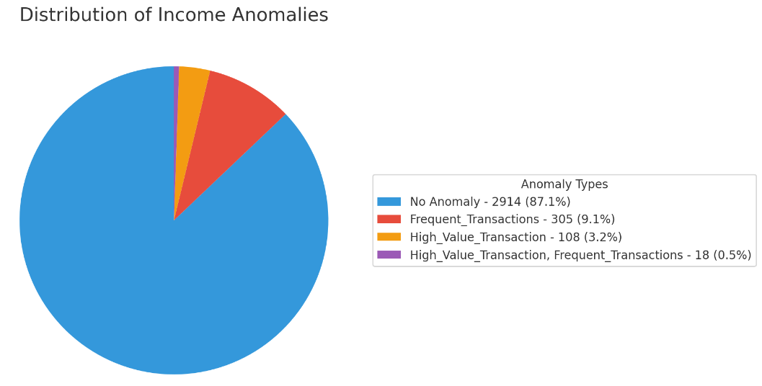
Fraud Detection
1
2
3

Slide 28
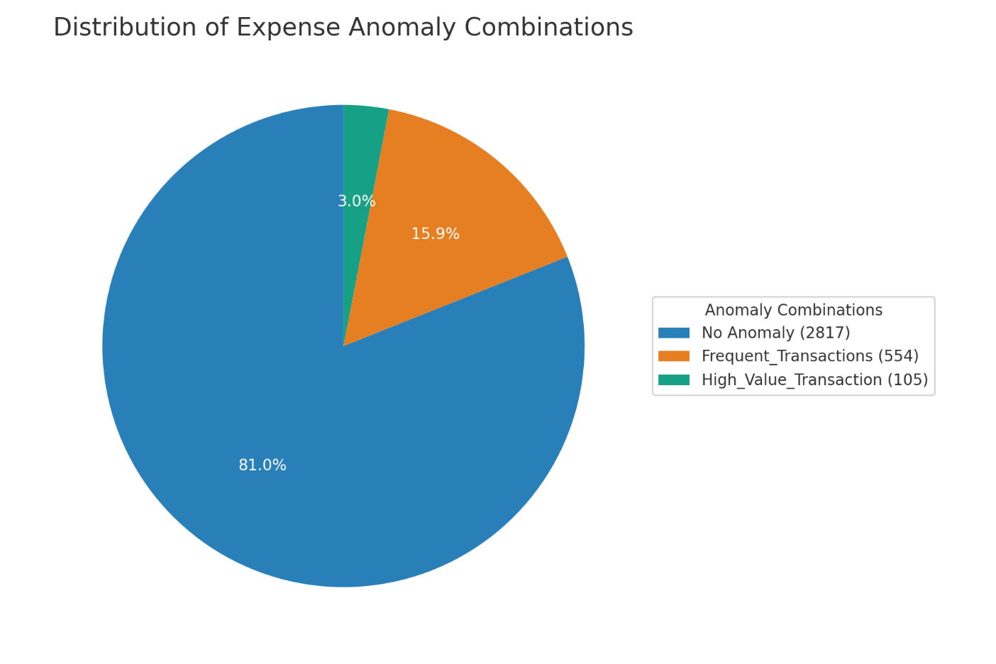
Fraud Detection
1
2
3

Slide 29
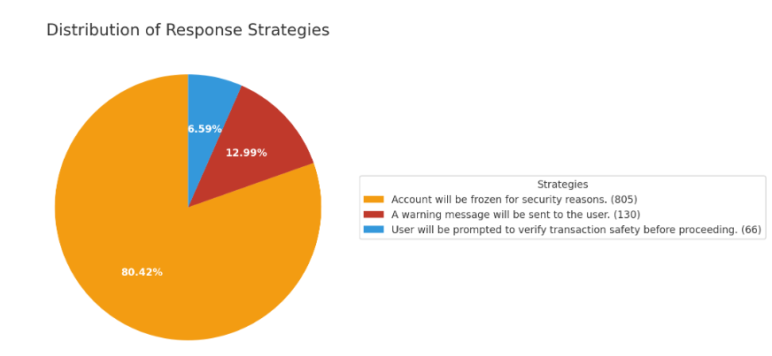
Fraud Detection
1
2
3

Slide 30
Any Questions?

Slide 31

2024.5.10

